Slide 1
COST EFFICIENT HOME SURVEILLANCE SYSTEM
CHETHAN G
1AY22MC023

Slide 2
Abstract
The home surveillance system getting more popularity day to day due to their ease of use and wide operational capabilities and more application. Face recognition is a technique used to identify a person from an image or a video feed. Face recognition system is to detect the face. After a face has been detected, certain information is extracted from the detected face and compared to known database to identify the person.
For the system, a Raspberry Pi 4 Model B has been used along with a camera module attached to it.
The basic concept here is that the face to be recognized is compared with some training set of known faces.
The aim is to achieve a low cost and reliable system which can be used for a variety of applications.

Slide 3
Introduction
This project deals with a design and implementation of smart surveillance monitoring system.
The proposed home security system captures information and transmits it via email and alert the user.
Face recognition is a technique used to identify a person from an image or a video feed.
For the system a “RASPBERRY PI 4” has been used along with a camera module attached to it.
Raspberry pi is a low cost, high performance microcontroller. Has its own RAM, USB ports, HDMI ports and micro SD card slot.

Slide 4
Programming language
Python:
Python is a high-level, general-purpose programming language. Its design philosophy emphasizes code readability with the use of significant indentation.
It was created by “Guido van Rossum, and released in 1991.
Python is dynamically-typed and garbage-collected.
Python 3.9.13 is the latest 3.9 version, and for now 3.9 will only get security updates.
Features:
Free and Open Source
Easy to Code and Read
Object-Oriented and High-Level Language
GUI Programming Support
It is a Portable, Integrated and Interpreted Language

Slide 5
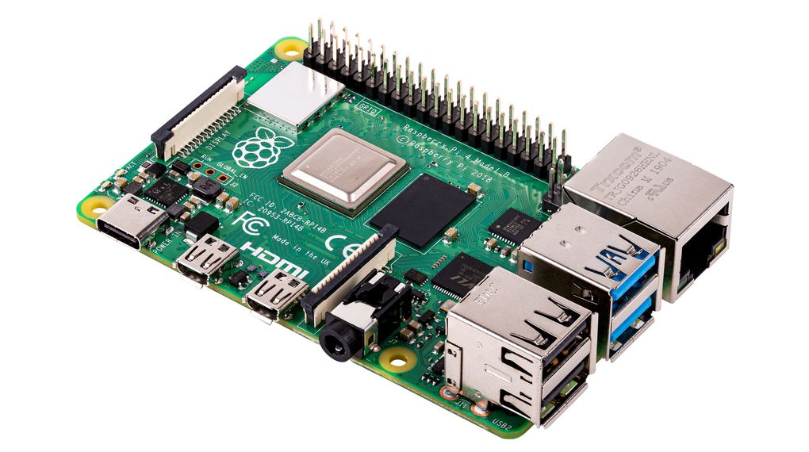
Components:
Raspberry pi 4 Model B
Pi camera/ Web Camera
Active buzzer alarm module
Travel Adapter
Keyboard and Mouse

Slide 6
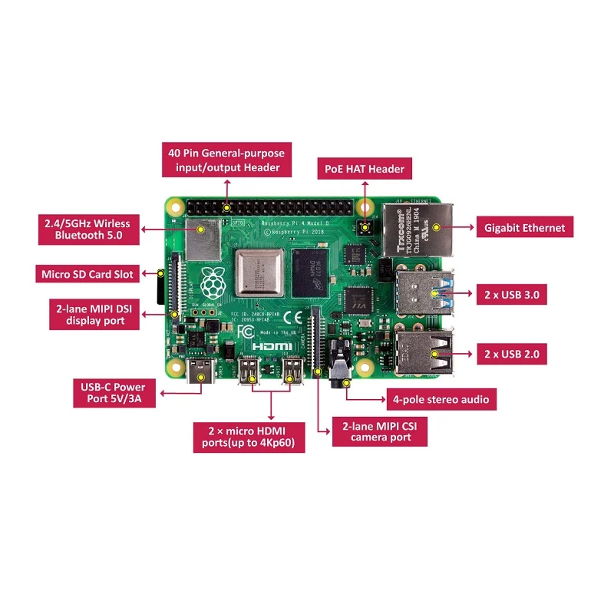
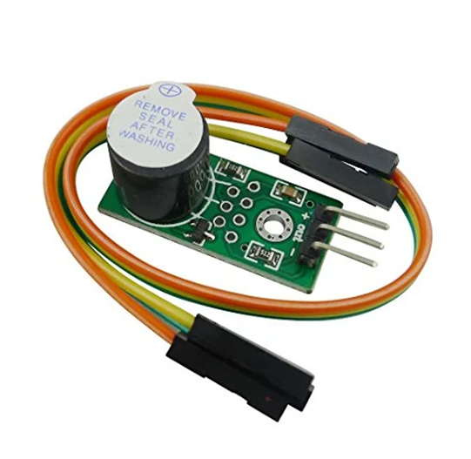
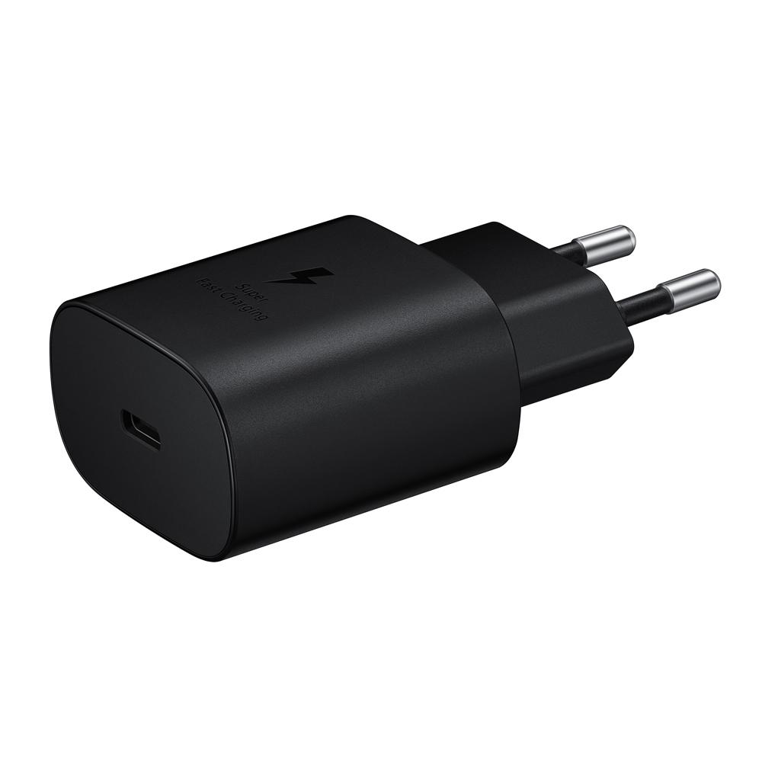
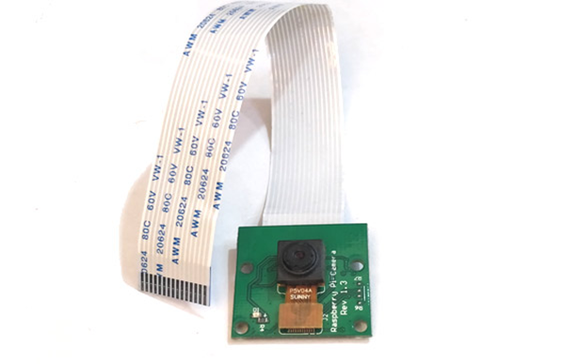
Raspberry Pi 4 Model B
Buzzer
Travel Adapter
Pi Camera

Slide 7
Specification
1. 1GB/2GB/4GB Variants
2. Quad-Core 64-bit Broadcom 2711, Cortex A72 Processor
3. WLAN 802.11 b/g/n/ac (2,4 + 5,0 GHz)
4. LAN RJ45 10/100/1000 Mbit (Gigabit LAN over USB 3.0)
5. Operating Power 5V@3A via USB Type-C port
6. Dual-Display Micro HDMI Ports which supports H 265 Decode for 4K Video @60p

Slide 8
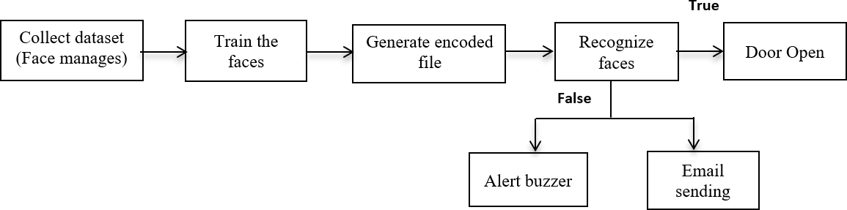
System Design

Slide 9
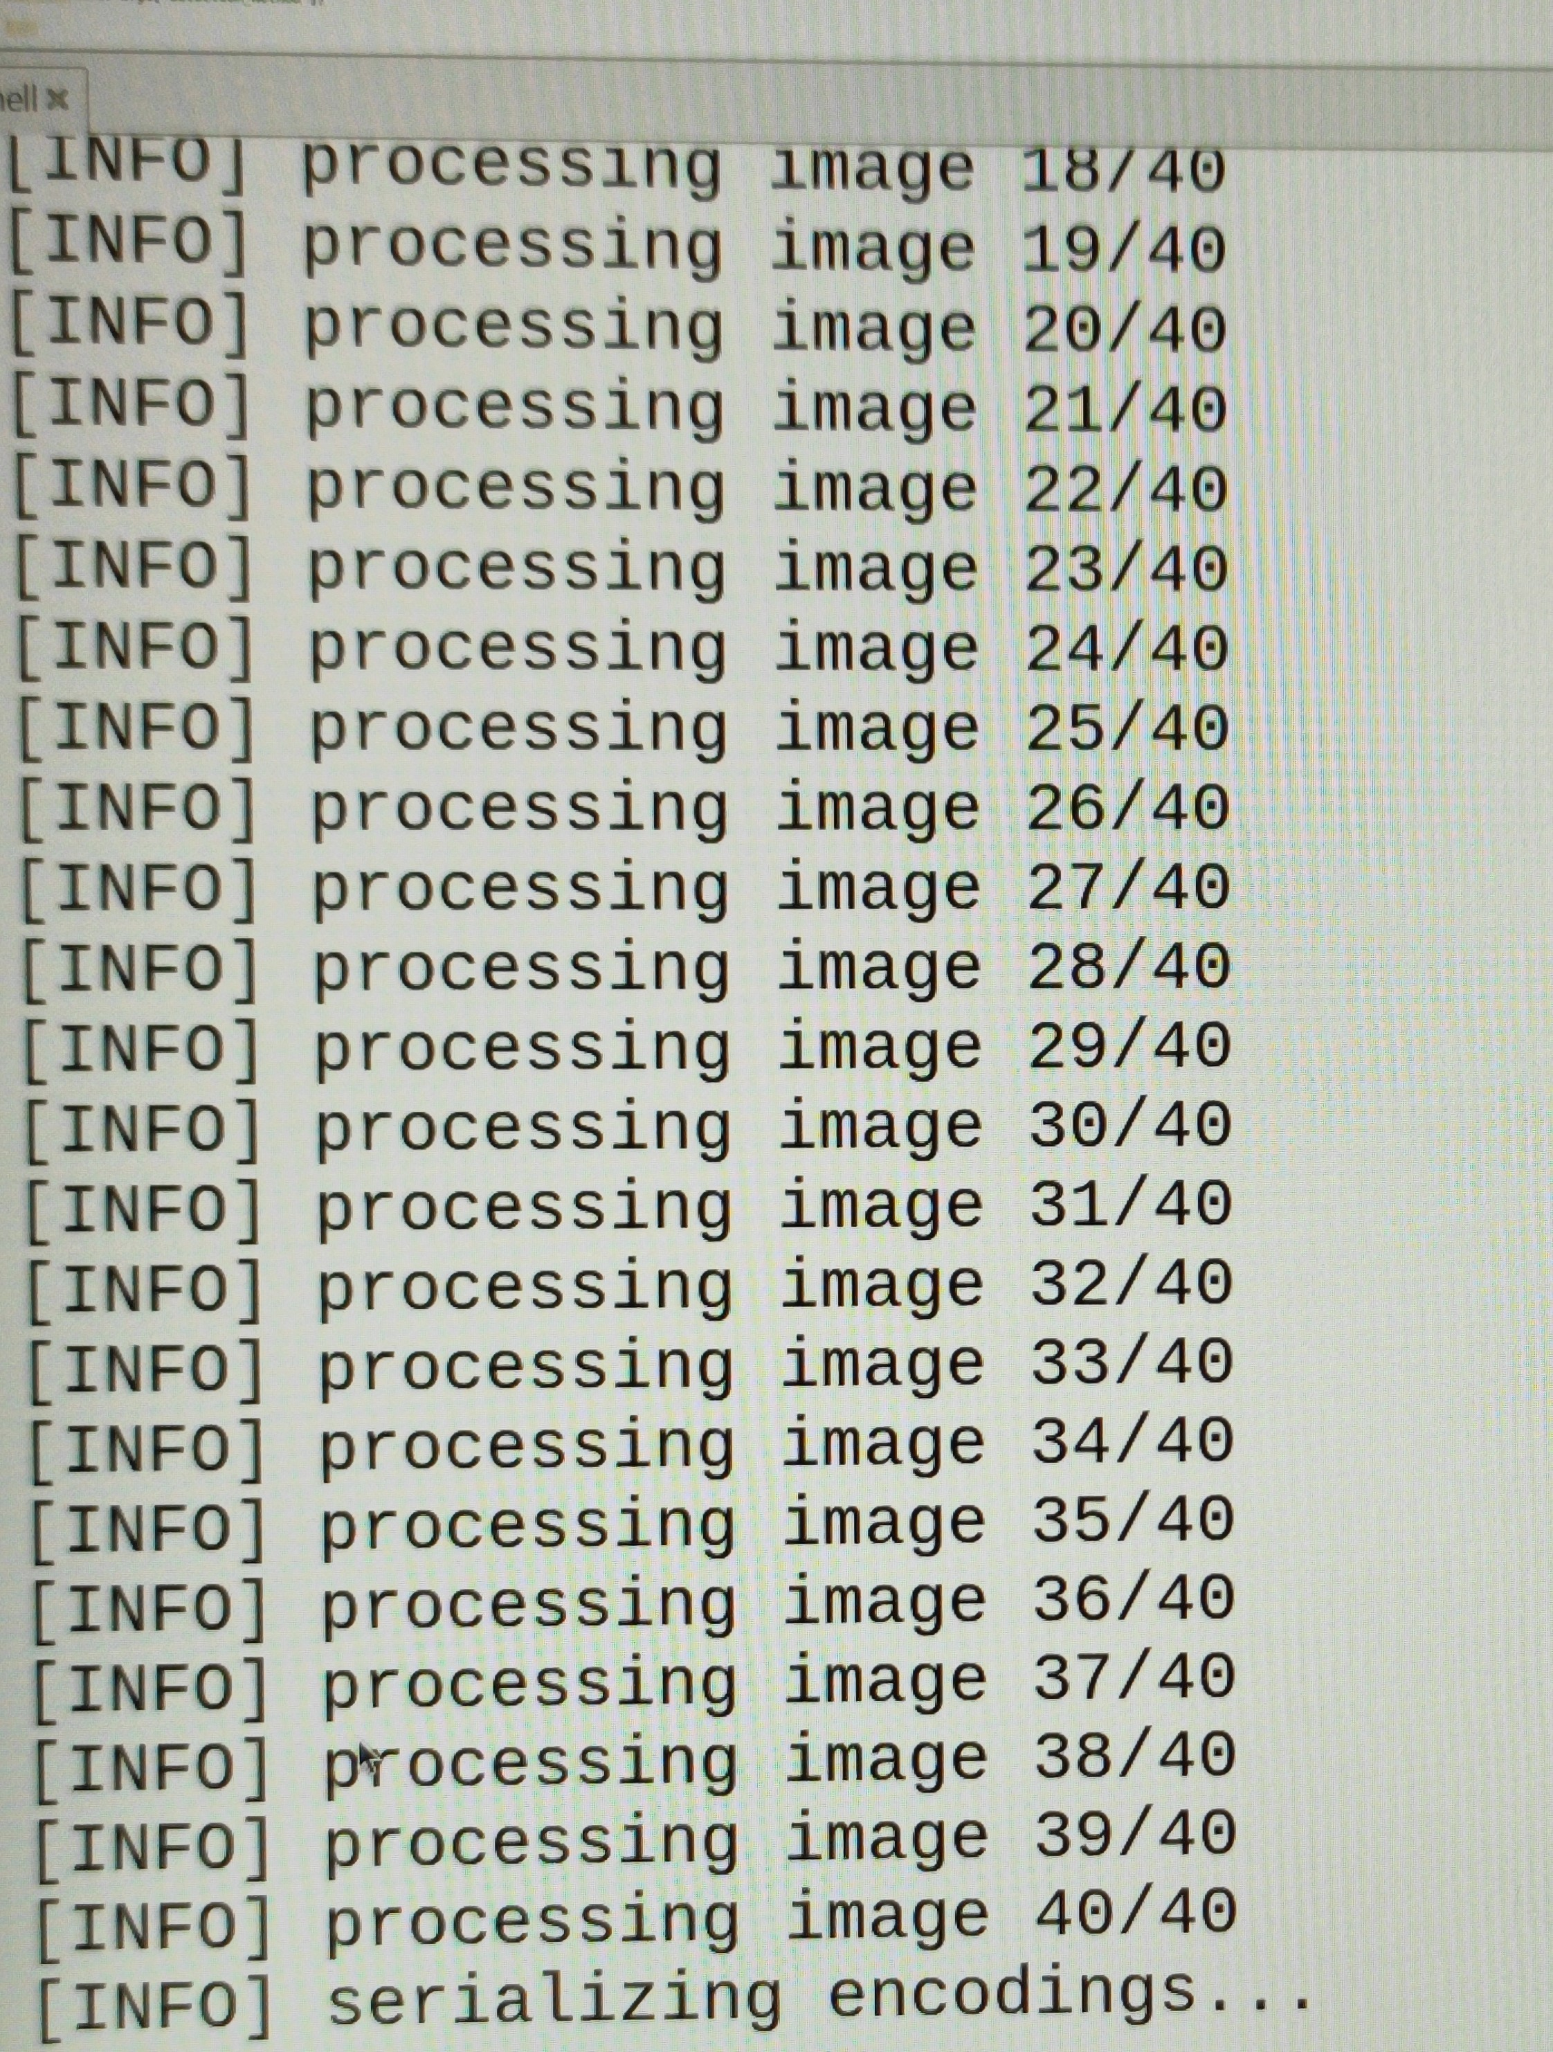
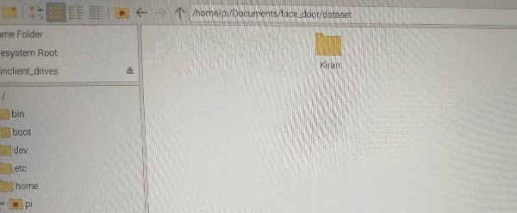
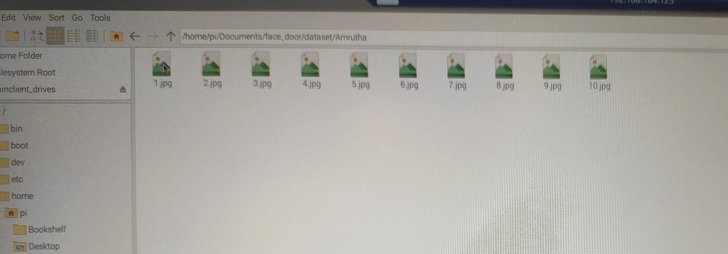
Screenshots
Fig. Collects Datasets
Fig. Train the faces

Slide 10
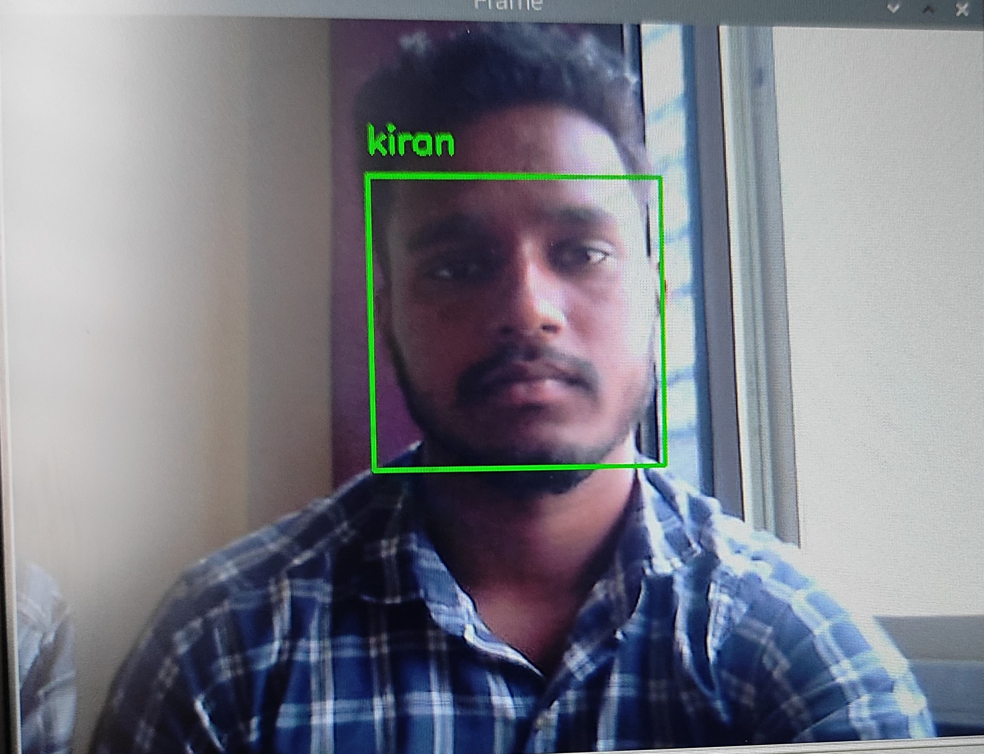
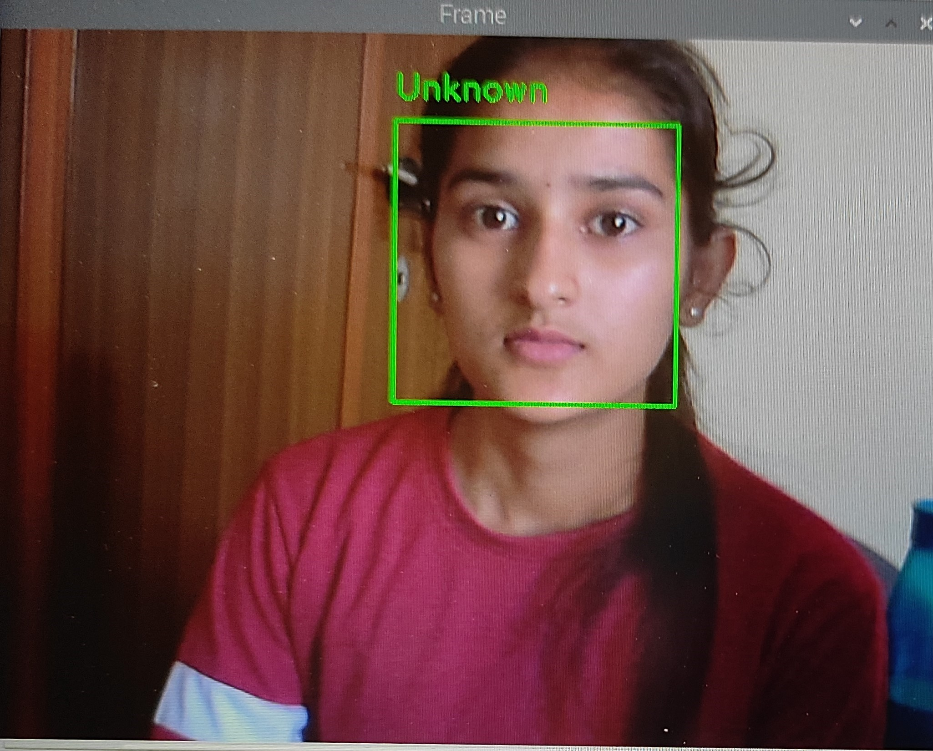
Administrator Face
Intruder

Slide 11
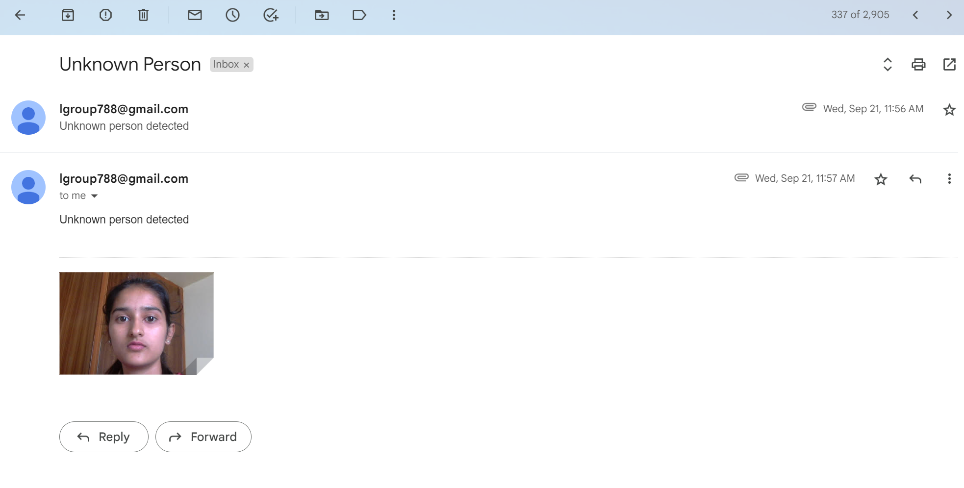
Fig. Showing an captured Image is sent to the Owner Email

Slide 12
Conclusion
The design of the face recognition system using Raspberry pi can make the smaller, lighter and with lower power consumption, so it is more convenient than the PC-based face recognition system.
It is a user-friendly system. This system can be used in several places where high security is required where confidential information and equipment is kept. For example, research institutes, banks, forensic Laboratories.
This project helps to reduce the problem of thefts and frauds. The analysis revealed that the present system shows excellent performance efficiency and can be used for face detection even from poor quality images. The field of face recognition is growing at a tremendous pace right now and the need for a low cost and reliable system is imperative.

Slide 13
Future Enhancement
The future scope of the project is to interface the hardware in order to control the door lock Arduino can be an interface to control the door lock on successful recognition of the face.
The Raspberry Pi Zero is a small form-factor board that comes in at half the size of a Model A+ without sacrificing the power you'd expect from an RPi. Both the Raspberry Pi Zero and Zero W feature the same BCM2835 SoC found on the original Raspberry Pi, but the W version has wireless functionality.
The Raspberry Pi Pico microcontroller board features a dual-core ARM Cortex-M0+ processor and an RP2040 microcontroller chip, along with 264KB internal RAM and 2MB QSPI flash memory. It has 26 GPIO pins, two SPI controllers, two I2C controllers, and 16 PWM channels, offering plenty of connectivity options.

Slide 14
Thank you

